Slide 1
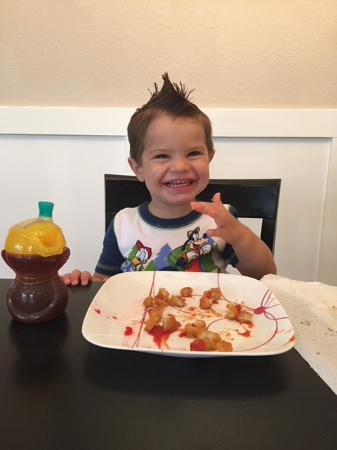
CHAPTERS 31-35
GROWTH AND DEVELOPMENT OF THE
INFANT, TODDLER, PRESCHOOLER,
SCHOOL AGE AND ADOLESCENT

Slide 2
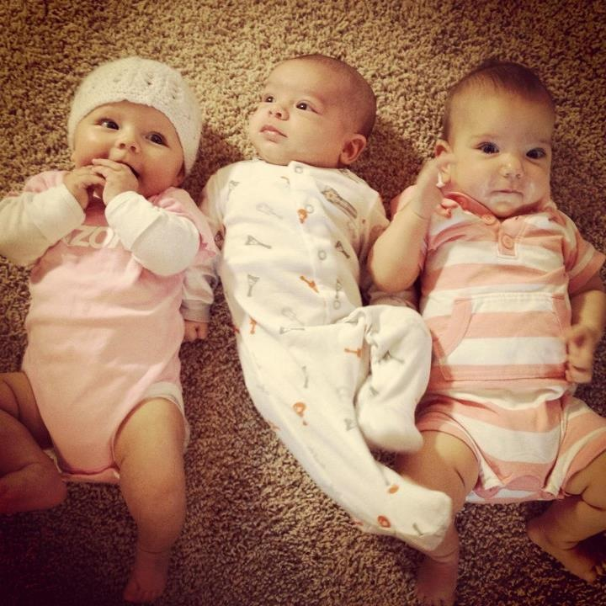
The Infant Growth & Development
5 to 7 ounces weight gain per week
Double birth weight by age 5-6 months
Triple birth weight by age 1 year
Height increases by 1 inch per month for 6 months
Height increases by 50% by 1 year
Growth in “spurts” rather than gradual pattern

Slide 3
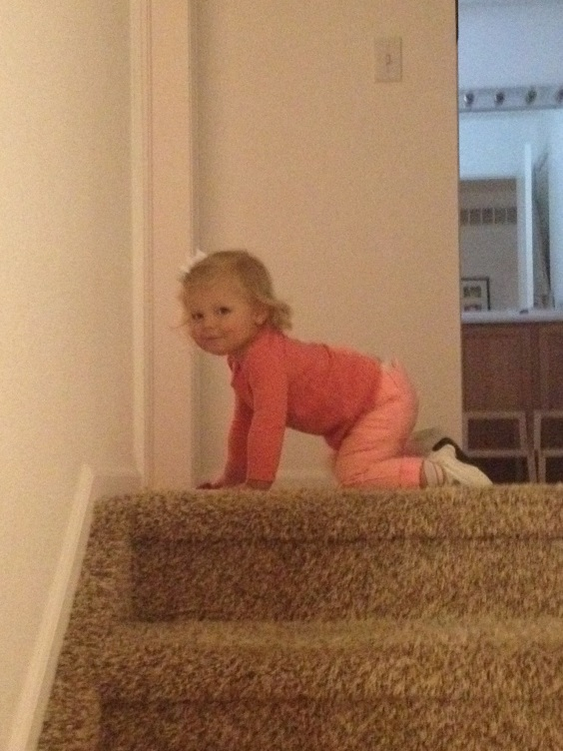
Locomotion
Cephalocaudal direction of development
Head, trunk, legs
Creeps on hands and knees
age – 9 months
Walk with assistance – 11 months
Walk alone – 12 months

Slide 4
Fine Motor Development
Grasping reflex disappears-3 months of age
Palmer Grasp -5 months (and drop)
Transfer object between hands – age 7 months
Pincer grasp age – 8 months
Holds rattle by the handle- 10 months
Remove objects from container – 11 months
Build tower of two blocks – 12 months

Slide 5
Gross Motor Development
Head control - 4 months
Rolling over – 5 to 6 months
Sits alone (tripod) – 7 months
Move for prone to sitting position – 10 months

Slide 6
How old infants sit steadily unsupported?
4month,
6months,
8 months, or
1 year

Slide 7
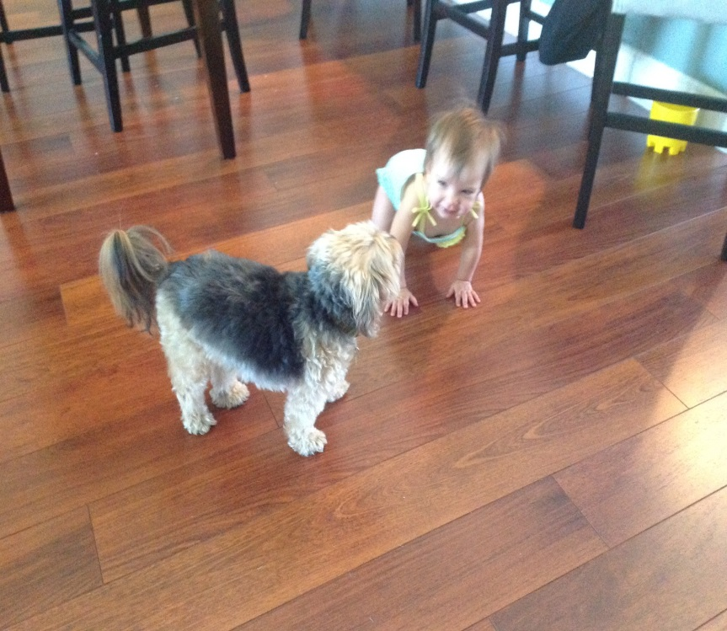
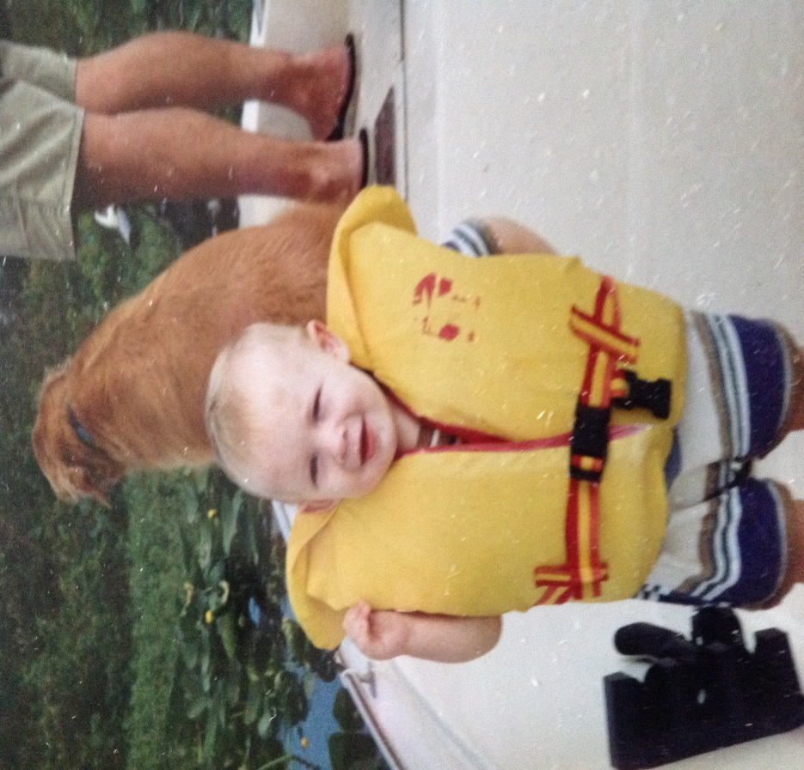
How old is infant when he/she can WALK?
How old is an infant when he/she Creeps?

Slide 8
Cognitive Development “ability to know”
Piaget Sensorimotor Phase (birth to 24 months)
Concept of object permanence – realization that objects that leave the visual field still exist (begins at 9-10 months)
By the end of the first year, recognize that they are separate from their parents.

Slide 9
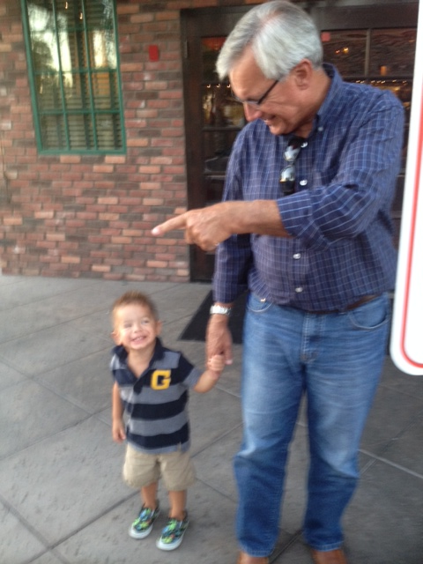
Social Development
Erickson TRUST VS MISTRUST
Attachment – the attachment of parent and child begins before birth and assumes even more importance at birth and continues through the first year. The mother or consistent caregiver is the focal person the infant typically attaches to .
Separation anxiety- between ages 4 to 8 months the infant has some awareness of self and parent
as separate beings.

Slide 10
Trust

Slide 11
Social Development
Stranger anxiety – between ages 6 and 8 months, fear of strangers and stranger anxiety become prominent and are related to infants’ ability to discriminate between familiar and unfamiliar people.
Play as major socializing agent – during the first year, play becomes more sophisticated and interdependent,

Slide 12
PLAY….Tactile Tub Time

Slide 13
Hospitalization
Think about the hospitalized infant and separation /stranger anxiety.
What might you expect to see and deal with in the hospital/clinic environment?

Slide 14
Language Development
Freud says this is WHAT stage of Development
Crying is first verbal communication
Vocalizations/cooing by 3 months
3 to 5 words with meaning by age 1 year

Slide 15
Promoting Optimum Health & Development during Infancy
Nutrition – breast milk is the 1st choice
for first 6 months of life
Introduce solid foods 4-6 months
Introduce foods in intervals of 4 to 7 days
to allow for identification of food allergies.
Weaning – refers to relinquishing the breast or bottle for a cup. 6m- 1year

Slide 16
Sleep
Sleep patterns vary, generally by 3 to 4 months sleep through the night 9 to 11 hours.
Total daily sleep is approximately 15 hours,
Safe to Sleep Campaign – Supine and room sharing (NO co-sleeping!) for infants to prevent SIDS (leading cause of death in infants 1-12 months of age) https://safetosleep.nichd.nih.gov/

Slide 17
Immunizations
One of the most dramatic advances in pediatrics has been the decline of infectious diseases during the 20th century due to the use of immunizations for preventable diseases.
https://www.cdc.gov/vaccines/schedules/
Review: ATI Nursing Care of Children-Chap 35

Slide 18
The Toddler
Ages 12 to 36 months
Intense period of Exploration
Language marks Cognitive Dev.
Piaget Sensorimotor 12-23 m
Piaget Preoperational Thought-2 years old

Slide 19
Injury Prevention
Unintentional injury was the leading cause of death in children between the ages of 1 and 9 years.
Motor vehicle injuries cause more accidental deaths in all pediatric age groups >1 yr old than any other type of injury
Car Seats – Children up to 2 years of age should ride in rear-facing car seat. Once child outgrows manufacture height and weight recommendations, use a forward facing car seat.

Slide 20
Poisoning
Poisoning is one of the major causes of death in children younger than 6 yearss of age.
Major reason for ingestion of poisons is improper storage.
Plants are another source of poisoning.
National Poison Control – 800-222-1222 or online at www.aapcc.org

Slide 21
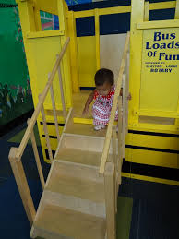
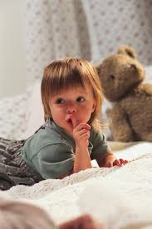
Preoperational Thought what is…Egocentric, Magical, Animism, Irreversibility

Slide 22
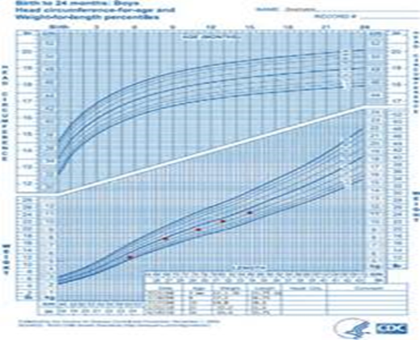
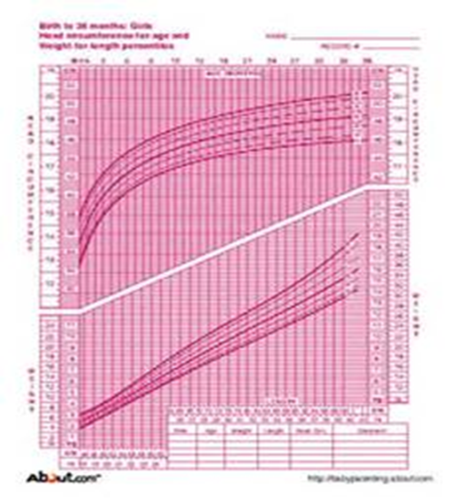
GROWTH OF TODDLER
By 2.5 years, toddlers are 4x their birth weight
Height increases about 3” per year
Growth is step-like rather than linear (plot it!)

Slide 23
Psychosocial Development Toddler
Erikson: Autonomy vs Shame or Doubt
Parallel, Pretend, and Magical Play
Ritualism or Schedules provide comfort
During Assessment approach slowly- Playful
Before making physical contact

Slide 24
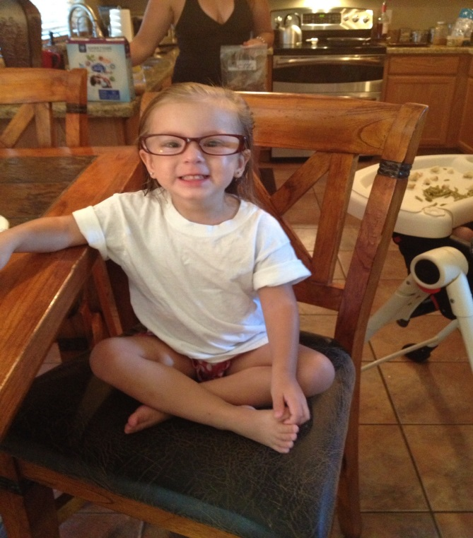
Sensory Changes
Vision 20/40 acceptable
Hearing, smell, taste, and touch increase in development
Uses ALL senses to explore & Learn

Slide 25
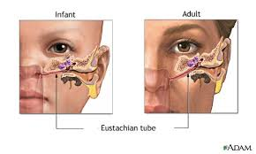
Maturation of Systems
Most physiologic systems relatively mature by the end of toddlerhood
Increase ENT infections r/t mobility, exploring, hand in mouth, and position of estuation tubes

Slide 26
Potty Training 18-36 months
Bowel readiness
Bladder readiness
Cognitive readiness
Motor readiness
Physiological readiness
PARENTAL readiness

Slide 27
Gross and Fine Motor Development
GROSS MOTOR
Locomotion
up & down stairs
toddle run
THROW & Kick a ball
FINE MOTOR
increase eye hand coordination
build a tower 6 cubes
turn pages book 1 at time

Slide 28
Temper Tantrums – toddlers assert their independence
Delayed Gratification
Negativism NO- give toddlers choices

Slide 29
Development of Body Image
Refer to body parts by name
Avoid negative labels about physical appearance
Begins to recognize sexual body difference, exploration of genitalia is common
Development of gender identity by age 3.

Slide 30
Preschooler Growth and Development
Preschool period – ages 3 – 5 years
Preparation for school
Erikson Initiative vs Guilt
Piaget Preoperative (begins to shift from egocentric to social awareness )
Freud Phallic (notice differences in appearance)
Ability to handle prolonged separation
Enjoy music & movement

Slide 31
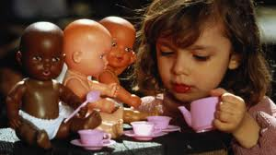
Biologic Development
Physical growth slows and stabilizes
Average weight gain remains about 5lbs/year
Average height increases 2½ to 3”/year

Slide 32
Language & Cognition
2100 word vocabulary by 5
Form 3-4 word sentences
Talk incessantly
ASK MANY MANY Questions
Magical thinking & imaginary friends common
Increased FEARS
Engage preschoolers in plan to tackle FEARS
Increased attention span and memory
Ability to follow 2 step command
Education is key to Safety
Beginning to understand cause & effect
No concept of TIME (instead explain by events, “after dinner mom will come home”)

Slide 33
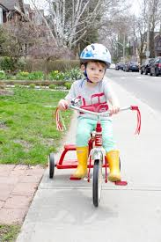
Gross and Fine Motor Behavior
GROSS MOTOR:
running, climbing, and jumping well established
Ride a Tricycle. Walk on tiptoes, balance 1 foot
FINE MOTOR
Dress themselves
Drawing, artwork, skillful manipulation

Slide 34
Spiritual Development
Knowledge of faith & religion learned from significant others
Development of conscience is strongly linked to spiritual development
May misinterpret illness as punishment from God
Important to emphasize that procedures are not a form of punishment!

Slide 35
Development of Body Image PRESCHOOLER
Increasing comprehension of “desirable” appearances
PRINCESS and FIREMAN
Aware of racial identity, differences in appearances,
Poorly defined body boundaries
Fear that if skin is “broken” all blood and “insides” can leak out
Intrusive experiences are frightening

Slide 36
Development of Sexuality PRESCHOOLER
Form strong attachment to the opposite sex parent while identifying with the same sex parent
Modesty becomes a concern
Sex role imitation, “dressing up like Mommy or Daddy”
Sexual exploration more pronounced
Questions arise about sexual reproduction
“YOU DON’T ASK IF SOMEBODY HAS A BABY IN THERE TUMMY”

Slide 37
Social Development
Individuation-separation process is completed
Overcome stranger anxiety and fear of separation from parents
Still need parental security and guidance
Security from familiar objects (bring favorite toy, blanket

Slide 38
Fears great part of preschool development
Dark
Being left alone
Animals (snakes, large dogs, etc)
Ghosts
Objects or people associated with pain
Play therapy beneficial for working through fears, anxieties, and fantasies
Preschoolers have imaginary friends during lonely times
Involve them in methods to cope with frightening experience

Slide 39
Injury Prevention
Abuse: as licensed professional, you are RESPONSIBLE
To report any SUSPECTED ABUSE
1-800-96-ABUSE in Florida
https://reportabuse.dcf.state.fl.us/
Development of long-term health safety behaviors
Bike helmets
Seat Belts
Life jackets
Hand Washing

Slide 40
Munchausen Syndrome by Proxy
Caregiver fabricates signs and symptoms of illness in child (the proxy) to gain attention from medical staff
Child may suffer needless and painful procedures and treatments – 10% of cases may be fatal to the child

Slide 41
School-Age Child Growth and Development
“School-age” 6 - 12 years old
Grow 2 inches a year & 5lbs
End of school age girls surpass boys
Erikson: Industry vs Inferiority
Loss of first deciduous teeth; ends with acquisition of final permanent teeth
Piaget: Concrete Operational (conceptual thinking)
Kohlberg: (right & wrong)

Slide 42
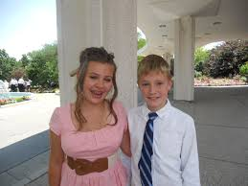
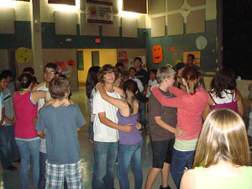
Prepubescence
Defined as 2 years before puberty
Puberty before 8 in girls and 9 in boys is considered PRECOCIOUS

Slide 43
TANNER STAGES
STAGES 1-5
Describes pubertal growth from stage 1 (immature) to stage 5 (mature)
Must be familiar with these stages! textbook pgs. 964-965

Slide 44
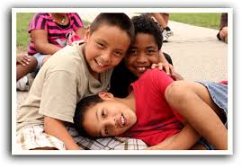
Psychosocial Development School Age
Relationships center around same-sex peers
Freud described it as “latency” period of psychosexual more interested in school & play
Clubs & Teams are very popular
Stress & Fears often expressed in physical complaints (goes to school nurse when exam, doesn’t have food)

Slide 45
Spiritual Development
Children think in very concrete terms
Children expect punishment for misbehavior
May view illness or injury as punishment for a real or imagined misdeed
School age child often revert & may request mommy hold hand during treatments

Slide 46
Injury Prevention School Age Teach Basic Rules of Safety
Accidents/unintentional injury leading cause of death
Teach benefits of bike helmets
Water safety
Appropriate safety equipment for all sports

Slide 47
Adolescent Promoting Growth and Development
Transition from childhood to adulthood
Rapid physical, cognitive, social, & emotional maturation
Increase demand for Sleep
Onset of puberty to cessation of body growth at 18 – 20 years

Slide 48
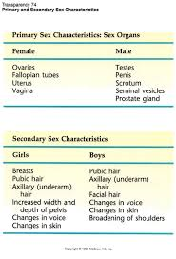
Biologic Development Adolescent
Primary Sex Characteristics
External & internal reproduction organs
Described in TANNER STAGES 1-5
Secondary Sex Characteristics
Hormonal changes; voice change, hair growth, breast enlargement, fat deposits
Play no direct role in reproduction

Slide 49
Physiologic Changes Adolescent
Size and strength of heart, blood volume, and systolic blood pressure increase
Pulse rate and basal heat production decrease
Adult lab values
Respiratory volume increase

Slide 50
Theorist Development
Erikson: Identity vs Role Confusion
Piaget Formal operation abstract thinking
Freud Genital (stage source tension & pleasure)

Slide 51
Relationships with Peers
Peers roles increase in adolescence
Peers provide sense of belonging , feeling of strength & power
Peers form transitional between dependence and autonomy

Slide 52
Injury Prevention Adolescent
MVA injury & death
Firearms/weapons
Sports injuries

